Slide 1

Nested Loops

Slide 2
Plan for today
Green Screen
Single looping: a deeper look
Nested looping
Drawing grids

Slide 3
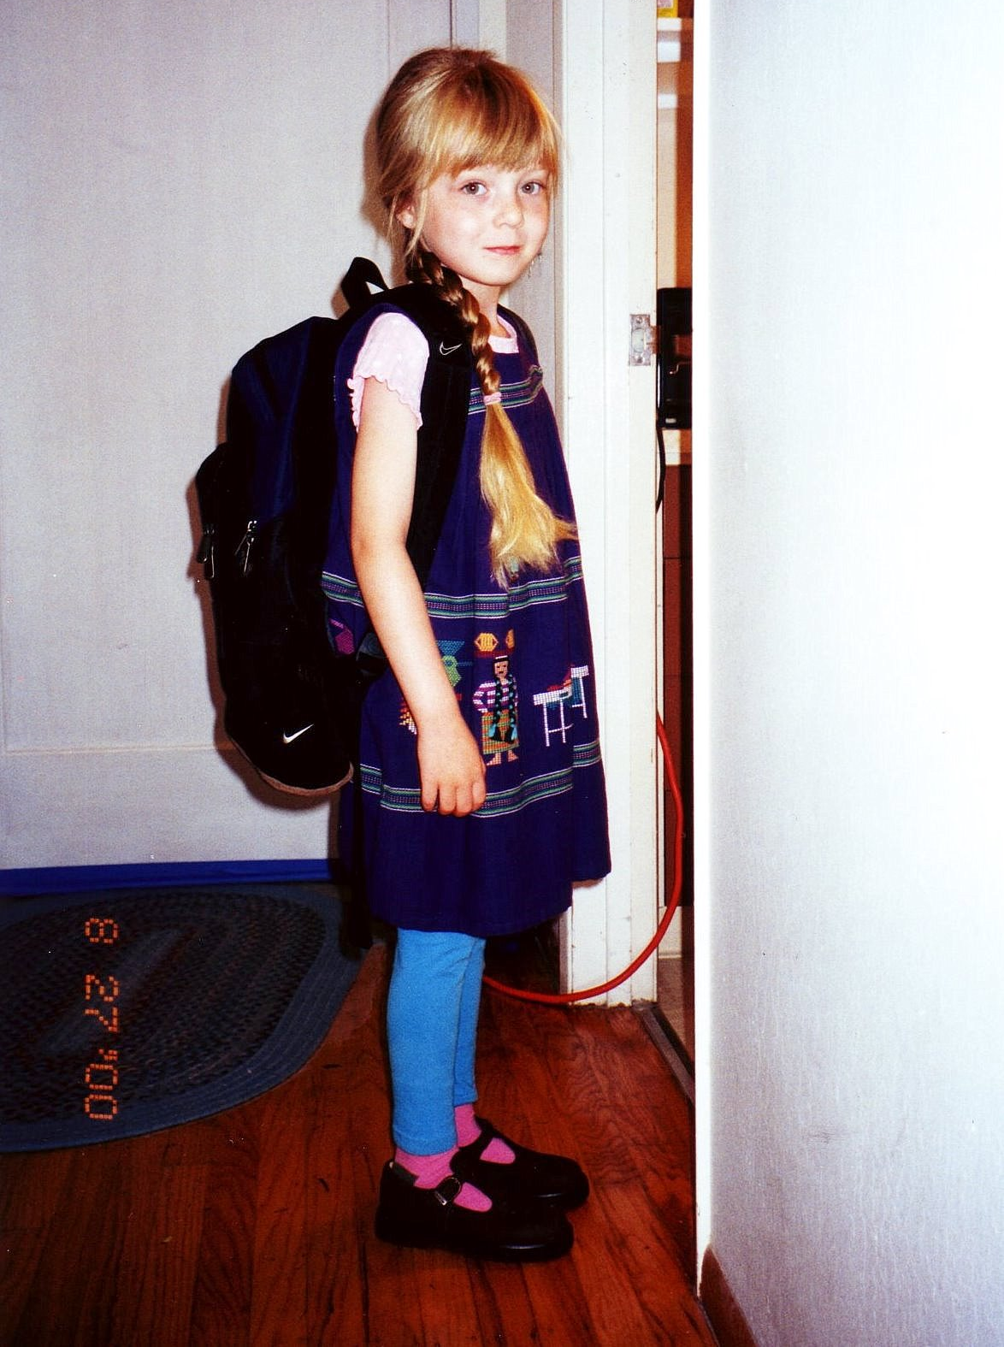
Julia in the past

Slide 4
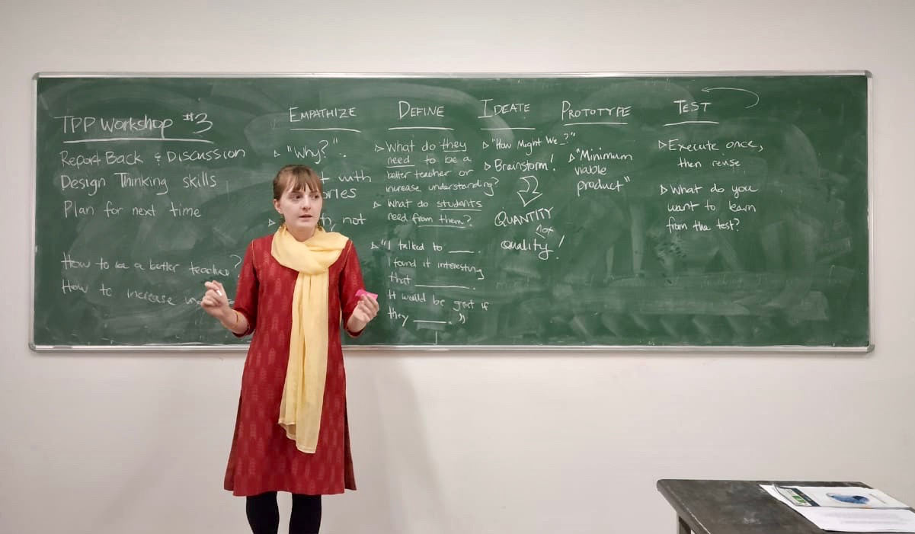
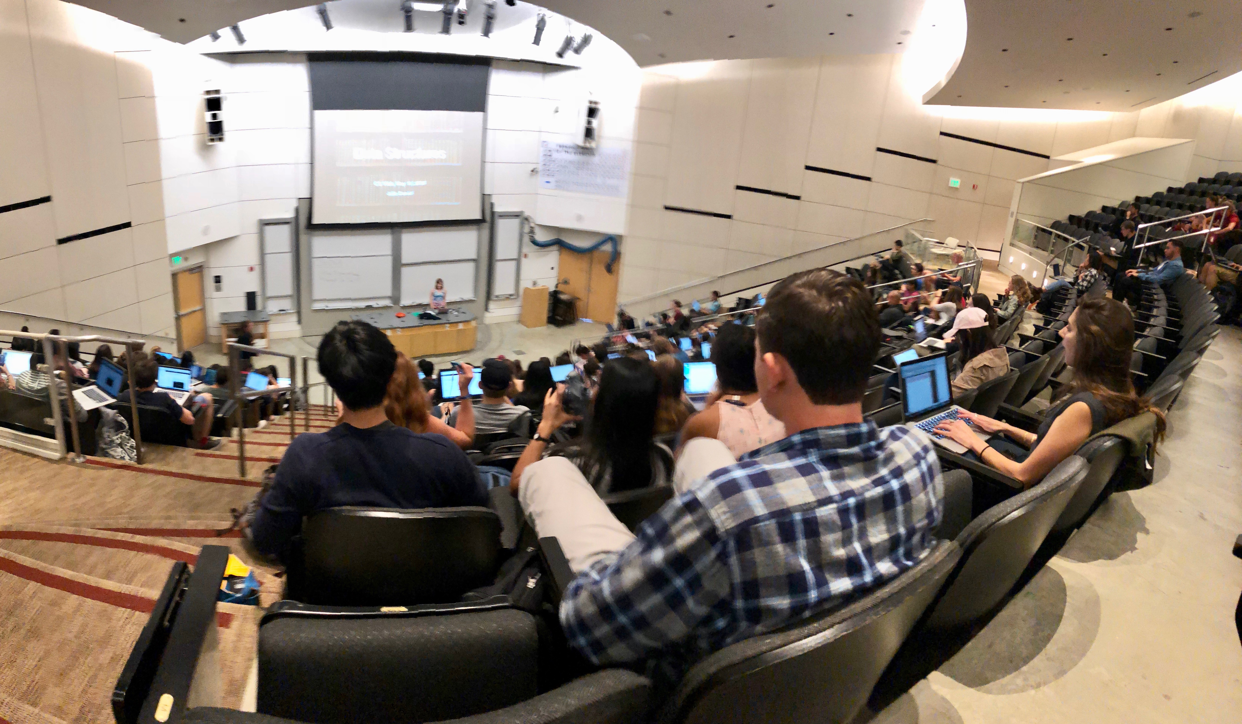
Julia in the past

Slide 5
The beginning of my journey
programming ability
my neighbor
me
time
Notes:
Así que comencé mi viaje y al principio me resultó difícil,
y vi a otros my neighbors que ya habían aprendido a programar

Slide 6
The beginning of my journey
The beginning is hard for everyone.
We are learning an entirely new way to think!
programming ability
my neighbor
10x better than me?
me
time
Notes:
Así que comencé mi viaje y al principio me resultó difícil, y vi a otros my neighbors que ya habían aprendido a programar
(click)
He enseñado a más de 5000 my neighbors de Stanford. Es duro para cada persona
(click)

Slide 7
Think about yourself
anything you want to learn
you
time
Notes:
Imagínate a ti mismo en una situación similar
Aquí el eje-x es el time.
Y el eje-y es lo que sea quieras mejorar.
Esta figura le falta algo

Slide 8
There are many learning paths
anything you want to learn
time

Slide 9
There are many learning paths
Grace Hopper
anything you want to learn
time

Slide 10
There are many learning paths
Maybe more realistic learning curves
anything you want to learn
time

Slide 11
There are many learning paths
We choose every day how hard we are going to work…
anything you want to learn
time

Slide 12
There are many learning paths
…and you being here now means you are more advanced than if you started later!
anything you want to learn
time

Slide 13
If you want to do something difficult, what’s important is how much you learn each day, not how much you know when you are 17.

Slide 14
Some syntax
// this works
sum = sum + num;
// so does this…
sum += num;

Slide 15
Some syntax
// this works
sum = sum + 1;
// so does this…
sum += 1;
// and this does too
sum++;

Slide 16
Some syntax
// this works
num = num - 1;
// so does this…
num -= 1;
// and this does too
num--;

Slide 17
How do you print “Czech this out!” 100 times?

Slide 18
For loop
public void run() {
for(int i = 0; i < 100; i++) {
println(“Czech this out!”);
}
}

Slide 19
For loop
Run the body of the loop if this is true
Executed once at the beginning of the loop
Executed every time the loop finishes
for(int i = 0; i < 100; i++) {
println(“Czech this out!”);
}

Slide 20

For loop
for(int i = 0; i < 3; i++) {
println(“Czech this out!”);
}
For Loop Redux

Slide 21
For loop
for(int i = 0; i < 3; i++) {
println(“Czech this out!”);
}
For Loop Redux

Slide 22
For loop
i
0
for(int i = 0; i < 3; i++) {
println(“Czech this out!”);
}
For Loop Redux

Slide 23
For loop
i
0
for(int i = 0; i < 3; i++) {
println(“Czech this out!”);
}
For Loop Redux

Slide 24
For loop
i
0
for(int i = 0; i < 3; i++) {
println(“Czech this out!”);
}
For Loop Redux
Czech this out!

Slide 25
For loop
i
1
for(int i = 0; i < 3; i++) {
println(“Czech this out!”);
}
For Loop Redux
Czech this out!

Slide 26
For loop
i
1
for(int i = 0; i < 3; i++) {
println(“Czech this out!”);
}
For Loop Redux
Czech this out!

Slide 27
For loop
i
1
for(int i = 0; i < 3; i++) {
println(“Czech this out!”);
}
For Loop Redux
Czech this out!
Czech this out!

Slide 28
For loop
i
2
for(int i = 0; i < 3; i++) {
println(“Czech this out!”);
}
For Loop Redux
Czech this out!
Czech this out!

Slide 29
For loop
i
2
for(int i = 0; i < 3; i++) {
println(“Czech this out!”);
}
For Loop Redux
Czech this out!
Czech this out!

Slide 30
For loop
i
2
for(int i = 0; i < 3; i++) {
println(“Czech this out!”);
}
For Loop Redux
Czech this out!
Czech this out!
Czech this out!

Slide 31
For loop
i
3
for(int i = 0; i < 3; i++) {
println(“Czech this out!”);
}
For Loop Redux
Czech this out!
Czech this out!
Czech this out!

Slide 32
For loop
i
3
for(int i = 0; i < 3; i++) {
println(“Czech this out!”);
}
For Loop Redux
Czech this out!
Czech this out!
Czech this out!

Slide 33
For loop
for(int i = 0; i < 3; i++) {
println(“Czech this out!”);
}
For Loop Redux
Czech this out!
Czech this out!
Czech this out!

Slide 34
For loop
for(int i = 0; i < 3; i++) {
println(“Czech this out!”);
}
For Loop Redux
Czech this out!
Czech this out!
Czech this out!

Slide 35
Think for a minute,
then talk to the person next to you:
How would we print the first 100 even numbers?

Slide 36
Use the loop variable!

Slide 37
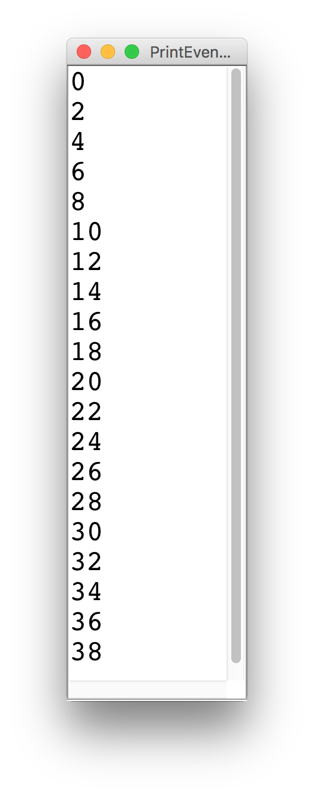
Printing even numbers

Slide 38
Printing even numbers
for(int i = 0; i < NUMS; i++) {
println(i * 2);
}

Slide 39
Printing even numbers
for(int i = 0; i < 3; i++) {
println(i * 2);
}
For Loop Redux

Slide 40
Printing even numbers
for(int i = 0; i < 3; i++) {
println(i * 2);
}
For Loop Redux

Slide 41
Printing even numbers
i
0
for(int i = 0; i < 3; i++) {
println(i * 2);
}
For Loop Redux

Slide 42
Printing even numbers
i
0
for(int i = 0; i < 3; i++) {
println(i * 2);
}
For Loop Redux

Slide 43
Printing even numbers
i
0
for(int i = 0; i < 3; i++) {
println(i * 2);
}
For Loop Redux
0

Slide 44
Printing even numbers
i
1
for(int i = 0; i < 3; i++) {
println(i * 2);
}
For Loop Redux
0

Slide 45
Printing even numbers
i
1
for(int i = 0; i < 3; i++) {
println(i * 2);
}
For Loop Redux
0

Slide 46
Printing even numbers
i
1
for(int i = 0; i < 3; i++) {
println(i * 2);
}
For Loop Redux
0
2

Slide 47
Printing even numbers
i
2
for(int i = 0; i < 3; i++) {
println(i * 2);
}
For Loop Redux
0
2

Slide 48
Printing even numbers
i
2
for(int i = 0; i < 3; i++) {
println(i * 2);
}
For Loop Redux
0
2

Slide 49
Printing even numbers
i
2
for(int i = 0; i < 3; i++) {
println(i * 2);
}
For Loop Redux
0
2
4

Slide 50
Printing even numbers
i
3
for(int i = 0; i < 3; i++) {
println(i * 2);
}
For Loop Redux
0
2
4

Slide 51
Printing even numbers
i
3
for(int i = 0; i < 3; i++) {
println(i * 2);
}
For Loop Redux
0
2
4

Slide 52
Printing even numbers
i
3
for(int i = 0; i < 3; i++) {
println(i * 2);
}
For Loop Redux
0
2
4

Slide 53
Printing even numbers
for(int i = 0; i < 3; i++) {
println(i * 2);
}
For Loop Redux
0
2
4

Slide 54
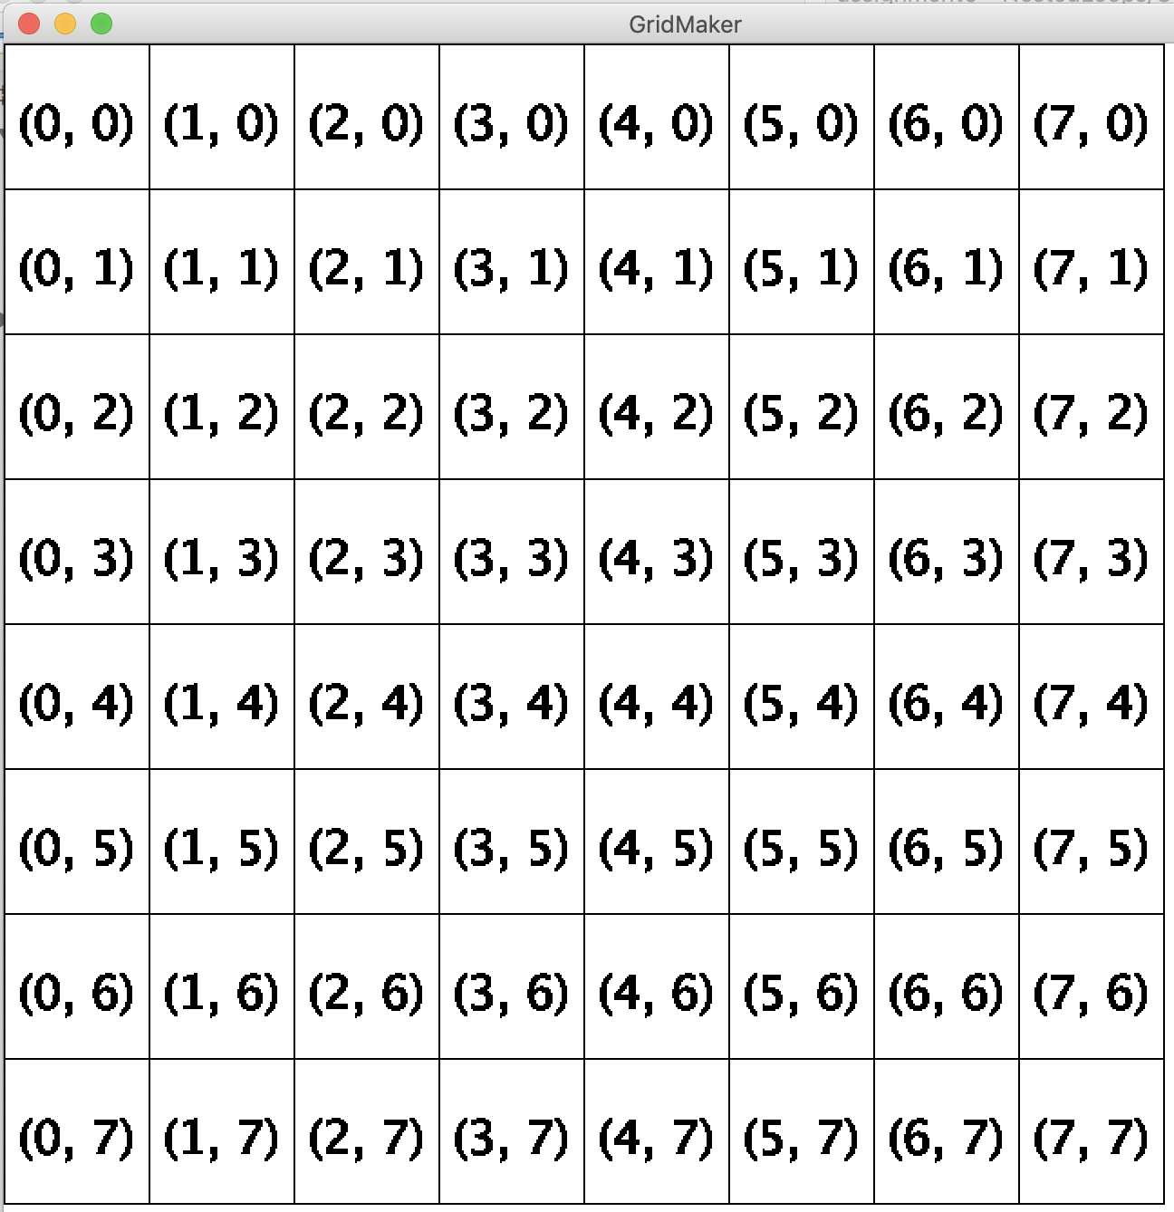
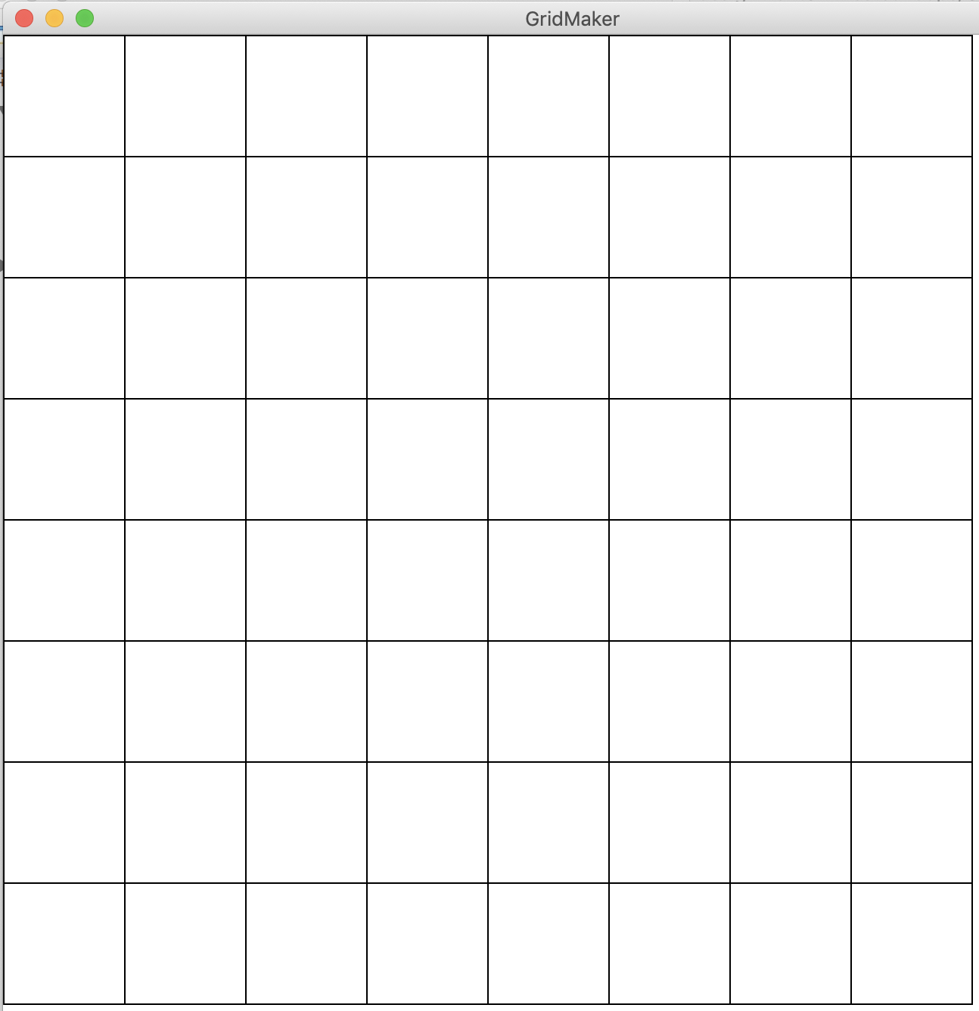
Draw a grid

Slide 55
Printing nested for loops
for(int i = 0; i < 3; i++) {
for(int j = 0; j < 2; j++) {
println(“i = ” + i + “, j = “ + j);
}
}
For Loop Redux
i = 0, j = 0
i = 0, j = 1
i = 1, j = 0
i = 1, j = 1
i = 2, j = 0
i = 2, j = 1

Slide 56
Draw a grid

Slide 57
So how does green screen work?

Slide 58

Changing images

Slide 59
Changing images
An image is made up of square pixels….

Slide 60
Changing images
0 1 2 3 4 5 6 7 8 9 10 11 12 13 14 15 16 17 18 19 20 21
0
1
2
3
4
5
6
7
8
9
10
11
12
13
14
15
… which we can think of as a grid with rows and columns

Slide 61
Changing images
0 1 2 3 4 5 6 7 8 9 10 11 12 13 14 15 16 17 18 19 20 21
0
1
2
3
4
5
6
7
8
9
10
11
12
13
14
15
We can look at each pixel like a box in a grid,
and change the ones we want to change!

Slide 62
Přeji vám hezký víkend!

